Slide 1

Abracadabra: It’s Time for Graduation
The University of Akron
College of Arts and Sciences
Academic Advising and Career Services
May 13, 2019
Notes:
Sophie – welcome, and then have each of us introduce ourselves

Slide 2

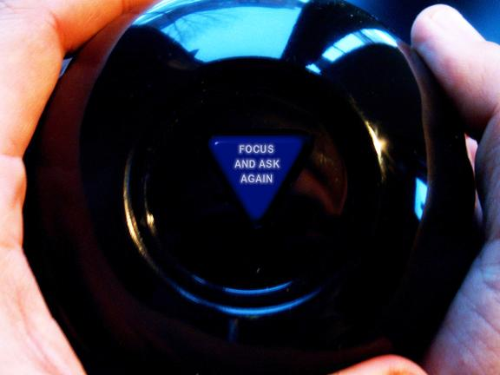
Ask the Magic Eight ball…
Notes:
Terry – explain – Terry and Gayle do Icebreaker and fun

Slide 3
Purpose
Collaborated to demystify
the graduation and
career transition processes
Notes:
Sophie - Short introduction on the purpose of this session

Slide 4
Demystifying Graduation and Career
Large institutions have many resources, but these are managed by different departments on campus
Students were asking us questions about graduation, commencement, and employment after college
We wanted to help students be more clear on the graduation process and career and job search skills
Notes:
Sophie will give explanation of need – we are just looking to improve student awareness of the graduation process and job search after graduation.

Slide 5
The Magic of Collaboration
New Career Services satellite office in the College of Arts of Sciences building
Sophie came by as any good neighbor would do! (but she had a greater purpose in mind)
We asked each other: how can Academic Advising and Career Services collaborate to best serve our students and to take advantage of the Five Star Friday schedule
Notes:
Mary – brief background of how this got started

Slide 6
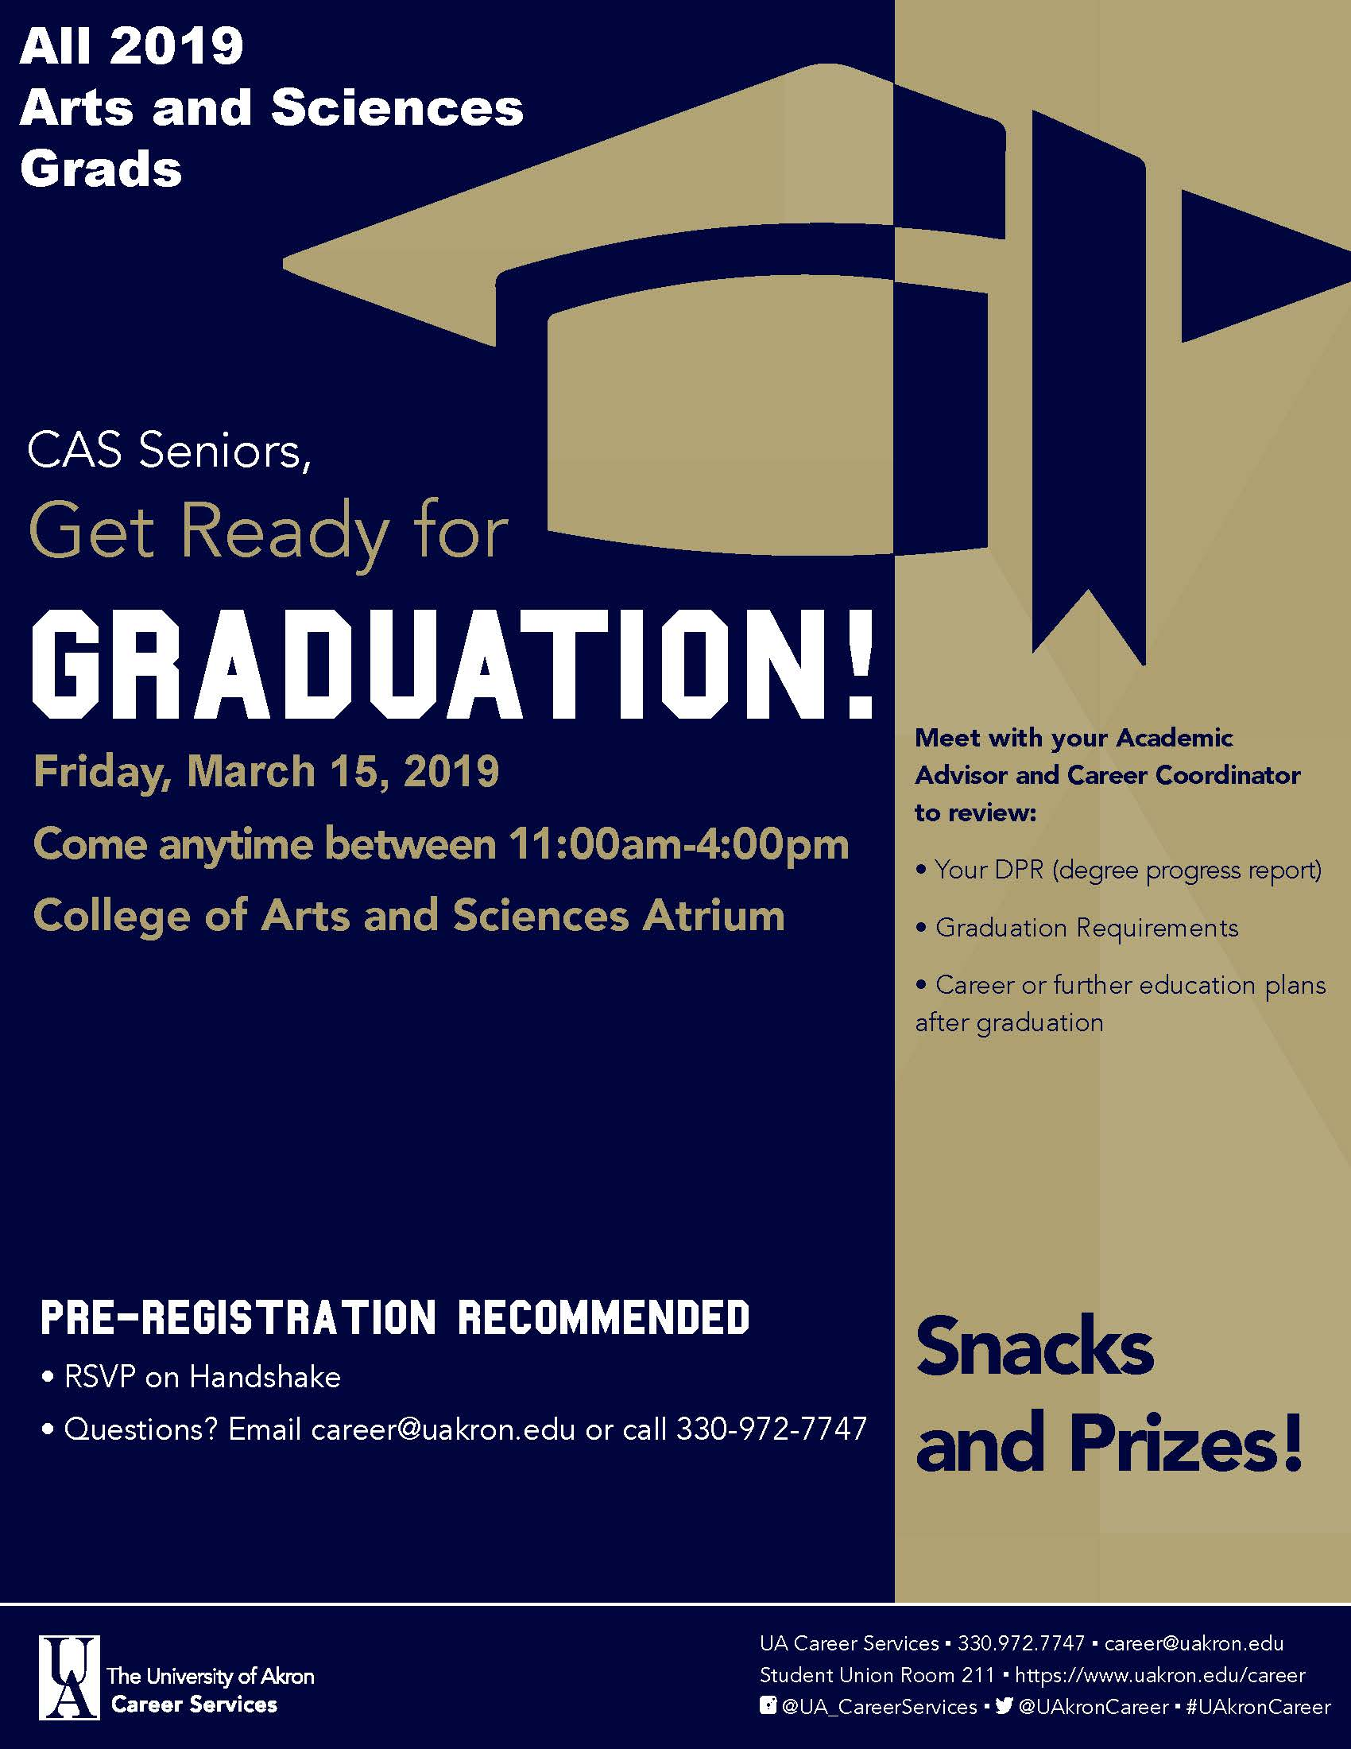
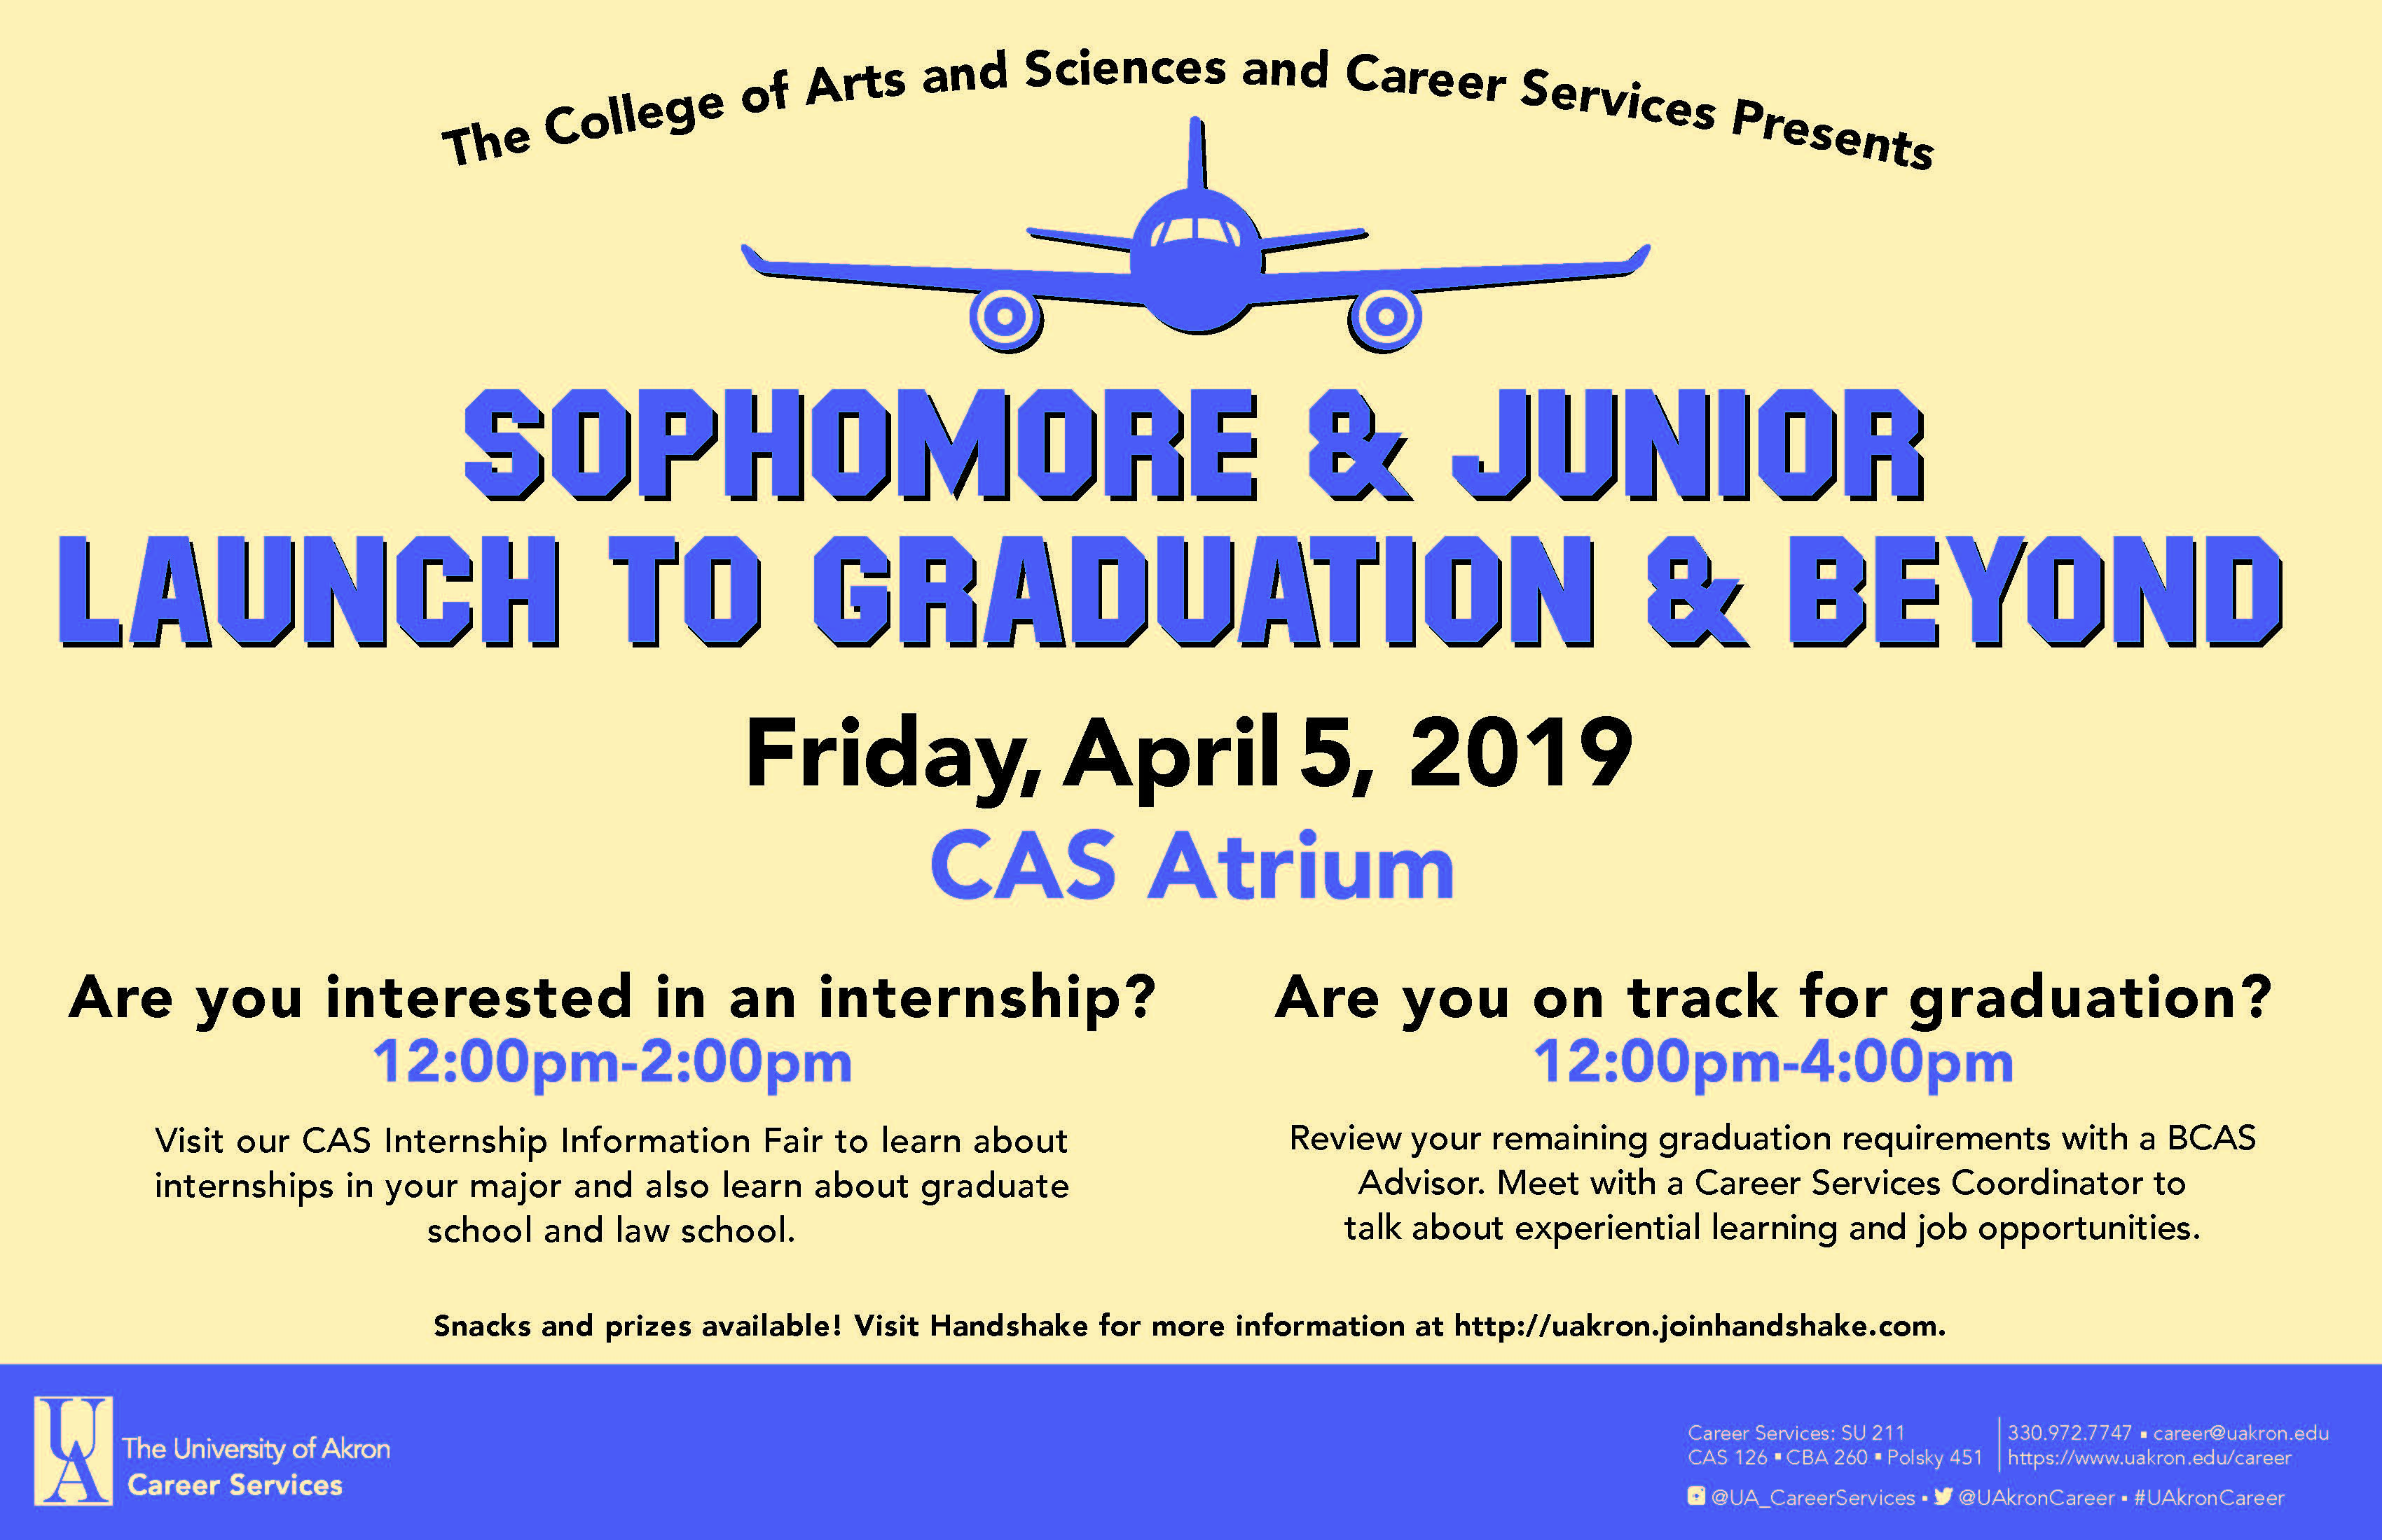
Notes:
Mary - This is the “case study” of these two events – the Get Ready for Grad Fair has been held for 2 semesters.

Slide 7
Goals for our Events:
Academic Advising: Help students understand their remaining degree requirements for graduation and to apply for graduation
Career Services: Meet with students on career skills and internship / job search tools – for many, this was their first conversation
Other Campus Departments: Collaborate with appropriate campus resources to inform students of their services and opportunities
Overall: Make the events fun and engaging and help students celebrate their progress and milestones
Notes:
Mary

Slide 8
Students were asking:
Am I ready to graduate?
Will I be able to walk?
How do I apply to graduate school?
How do I get a full-time
career job?
Academic Advising
met with Career Services
to answer these questions.
1
2
01
04
02
We developed “one-stop shopping” events:
Get Ready for Graduation
and
Launch to Graduation and Beyond
and invited other relevant departments to be
at the events.
Post events:
Assessment
and
planning future events!
3
4
03
Notes:
Terry - Overview of the Process in Developing the Events

Slide 9
1
Students were asking:
Am I ready to graduate?
Will I be able to walk?
How do I apply to graduate school?
Oh my gosh, now I need a full-time job!
How do I get one?
01
04
02
03
Notes:
Terry

Slide 10
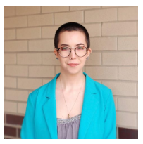

1
01
04
02
03
Notes:
Terry

Slide 11
2
Academic Advising
met with Career Services
to address these questions.
01
04
02
03
Notes:
Gayle

Slide 12
We developed
“one-stop shopping” events:
Get Ready for Graduation
and
Launch to Graduation and Beyond
and invited other relevant departments to be at the events.
01
04
02
03
3
Notes:
Gayle

Slide 13
01
4
04
02
Post events:
Assessment and planning future events!
03
Notes:
Gayle

Slide 14

Event Assessments
With each event we surveyed our students and the stakeholders who attended the event
The response rate improved with each event as did our surveys and method
We learned from feedback and planned subsequent events to better serve students and stakeholders
Notes:
Gayle

Slide 15
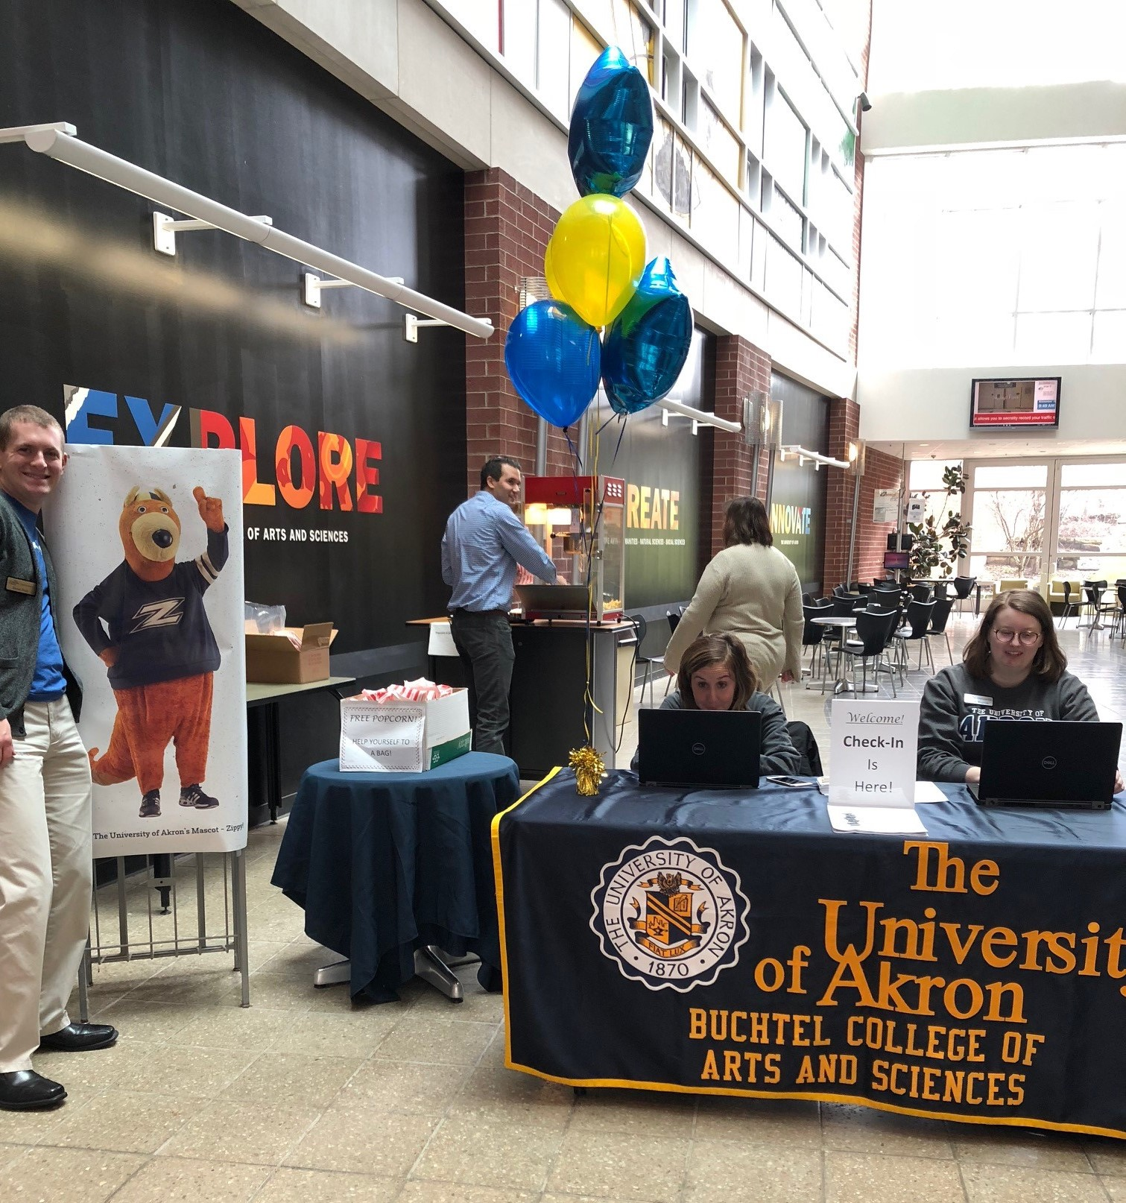
Get Ready for Graduation
Check In and Popcorn!
Students received a card that academic advisers and career coordinators would sign …
Notes:
Mary - give overview of structure of the event.

Slide 16
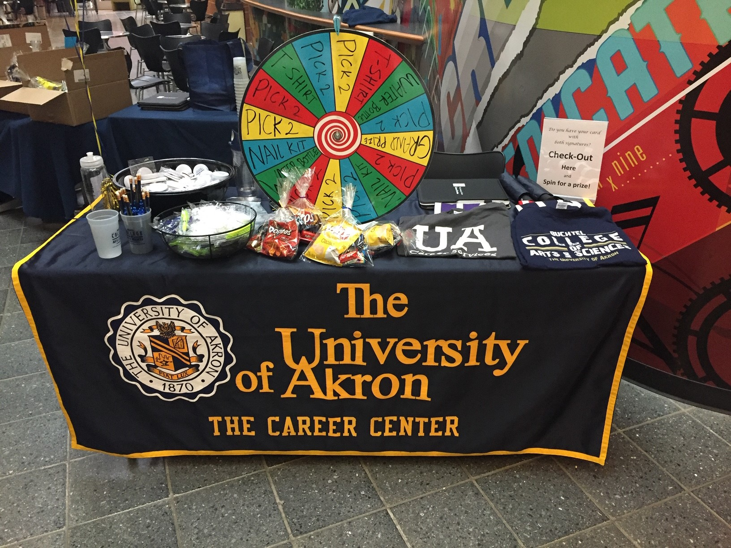
Get Ready for Graduation
… so students could pick up their bag of goodies and spin for a prize.
Notes:
Mary

Slide 17
Get Ready for Graduation
Target audience: Rising Seniors
Dates:
Friday, March 15, 2019 11am - 4pm
Friday, November 16, 2018 10am – 1pm
Administrative: Dean’s Office sent senior discrepancy reports
Marketing: Emails (from advisers and Handshake) sent out to 1700 seniors;
Posters and Campus Ads
Outcome:
52 of 110 rsvps attended on 11/16/18
54 of 137 rsvps attended on 3/15/19
Registrar to apply for commencement
Academic advisers to review DPR
Career counselors to review resume and discuss job search
Notes:
Mary - Our first and second events. The targeted audience was not those seniors graduating in the semester of the event, but rather those who needed to plan their final semester of classes (students who had completed 90 credit hours – with up to 30 to go).

Slide 18

Get Ready for Graduation Student Surveys
No survey data for initial event in November 2018
1 Student Response for second event in March 2019
Our initial surveys had 12 Questions – too many!
Notes:
Terry - Tell that we will use word clouds to summarize responses

Slide 19
Sample Questions Asked for Get Ready for Graduation in March
How did you hear about the Get Ready for Graduation Event? (check all that apply)
Word of mouth
Email
Adviser
Did you attend all the department resources (Career Services, Academic Advising, and Commencement at the event?
Did the Career Services Coordinator answer your questions about employment, resume preparation and interviewing?
Did the Academic Adviser answer your questions about your degree requirements or Degree Progress Report (DPR) for graduation?
Notes:
Terry

Slide 20

Student response (Get Ready for Graduation in March)
Notes:
Terry

Slide 21
Academic Adviser, Career Coordinator and Registrar Survey Questions (for both Get Ready for Graduation and Launch to Graduation and Beyond)
Did you find the events were helpful? Please explain your answer.
Would you recommend continuing these events for future semesters? Please explain your answer.
Do you have any suggestions to improve these events? If yes, please explain.
Notes:
Sophie - These were the questions provided to the Career Services Coordinators, Academic Advisors, Office of the Registrar, and Internship Coordinators (for the Sophomore and Junior event)

Slide 22
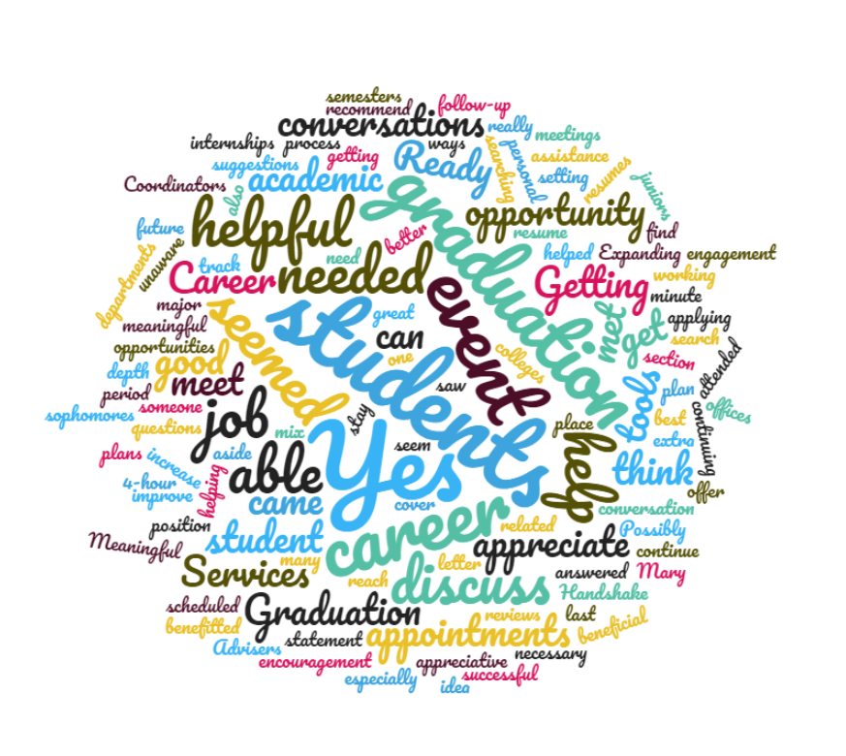
Feedback from Career Services Coordinators on the “Get Ready for Graduation” event for rising seniors:
Notes:
Sophie – each office was very happy to meet with over 50 students in a 4-hour period.

Slide 23
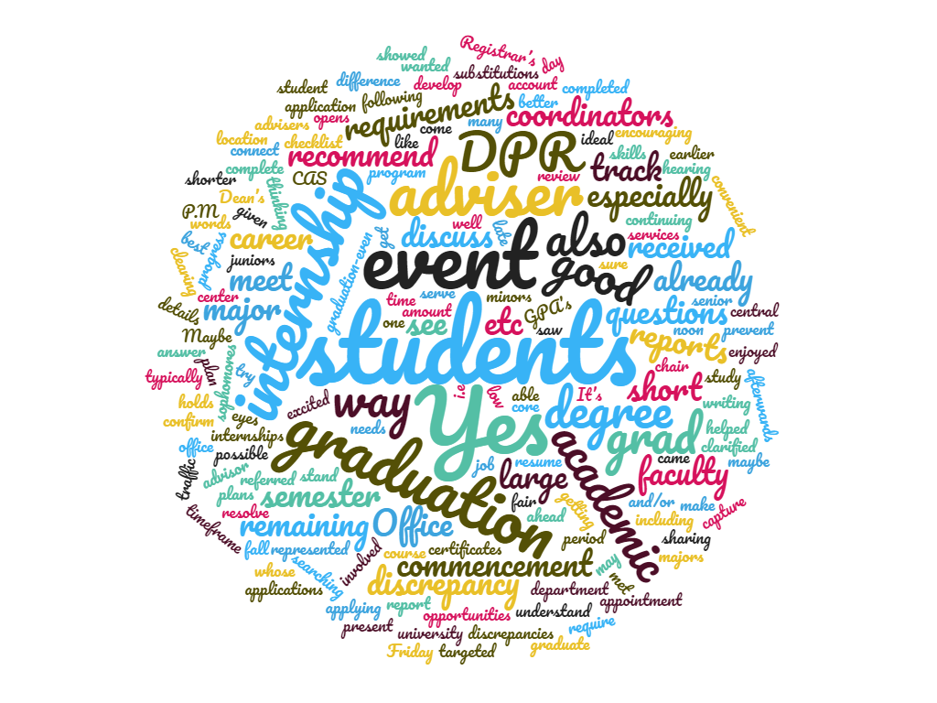
Feedback from Academic Advisers on the “Get Ready for Graduation” event for rising seniors:
Notes:
Sophie - Ironed out discrepancies in DPR and finalized degree requirements.

Slide 24
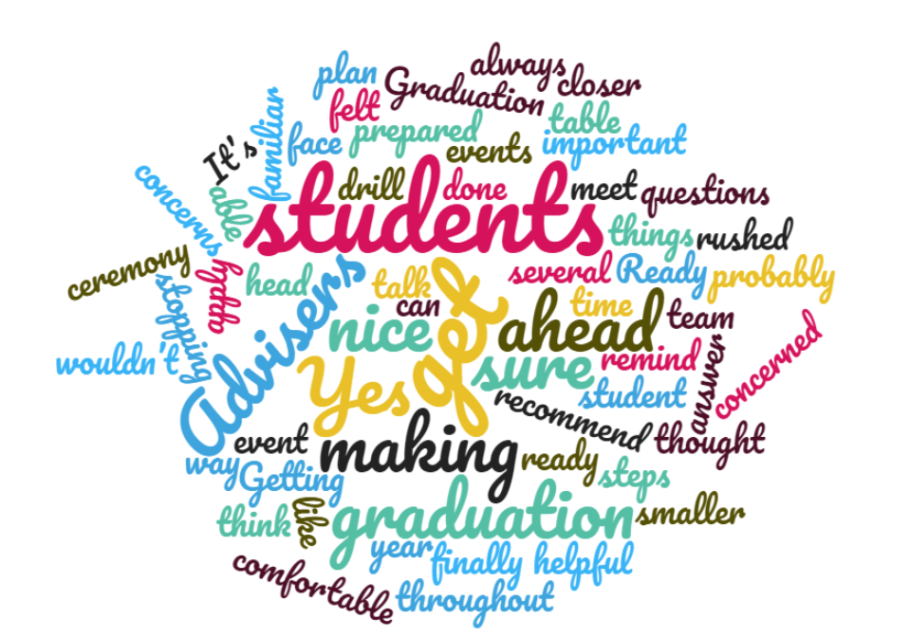
Feedback from Registrar’s Office on the “Get Ready for Graduation” event for rising seniors:
Notes:
Sophie - They answered many questions which saved a lot of time and effort of students asking closer to Commencement.

Slide 25
Launch to Graduation and Beyond
Target audience: Sophomores and Juniors
Date: Friday, April 5, 2019 11AM-4PM
Marketing:
Emails (from advisers and Handshake) sent to 1575 sophomores and juniors;
Posters and Campus Ads
Outcome:
57 of 78 rsvps attended on 4/5/19
Internship coordinators to discuss internships
Academic advisers to review DPR
Career Services coordinators to discuss experiential learning opportunities and strategies
Notes:
Gayle – internship coordinators from different majors; students were waiting in line before Noon to be able to talk to internship coordinators.

Slide 26
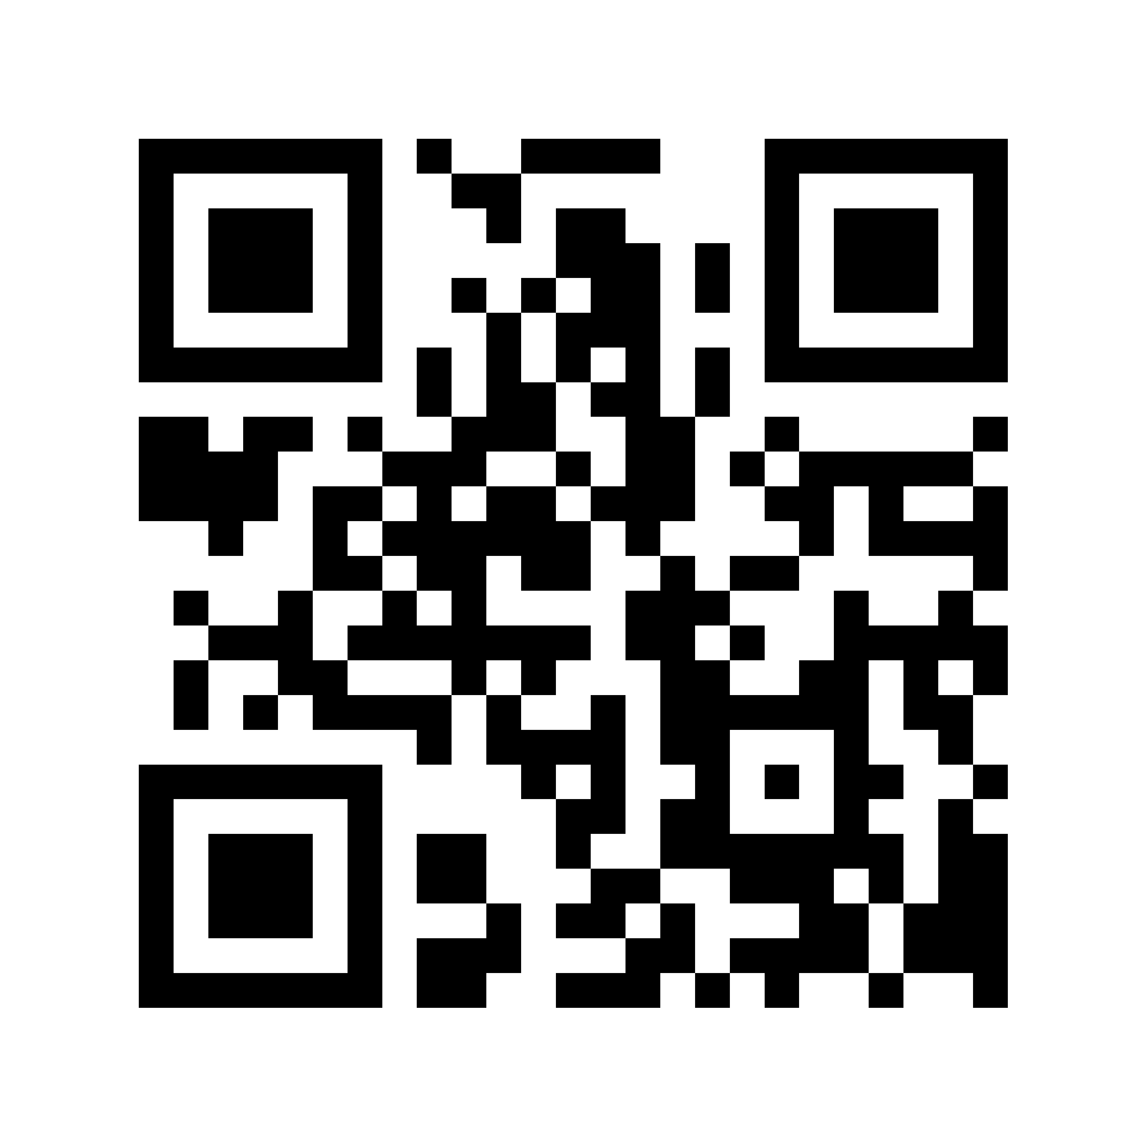
Student Survey for Launch to Graduation and Beyond
4 Questions – much better
We tried a QR code to have students respond while finishing at the event, but all were not recorded due to a technical glitch.
22 of 57 student responses for event on 4/5/19
38% response rate
Notes:
Gayle

Slide 27
Student Survey Results Launch to Graduation and Beyond
Questions:
1. How beneficial was this event for you? 4.227
2. Do you feel your are now better informed about your progress towards your degree completion? 4.136
3. Do you feel you are better informed about internships and experiential learning? 4.045
4. Please give us any additional comments you would like to share
Total Average for Questions 1-3: 4.136
Rating Scale:
1 = poor
5 = excellent
Notes:
Gayle

Slide 28
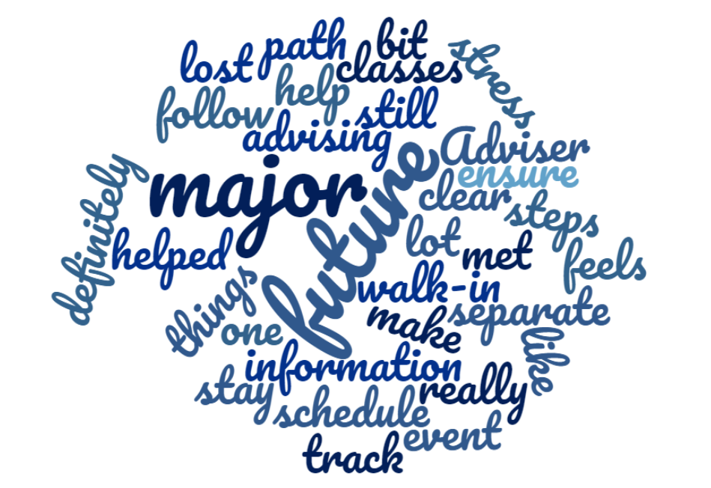
Feedback from students on the Launch to Graduation and Beyond:
Notes:
Mary - Great results – focusing on their major and on their future.

Slide 29
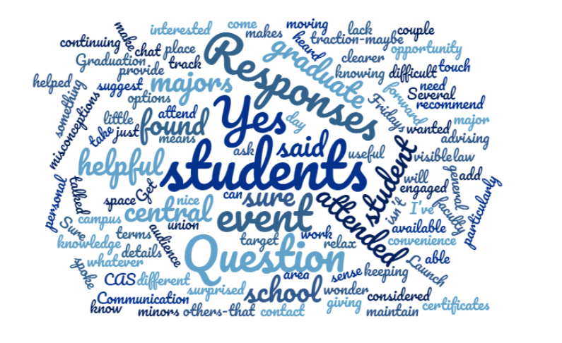
Feedback from faculty/staff at Launch to Graduation and Beyond:
Notes:
Mary

Slide 30
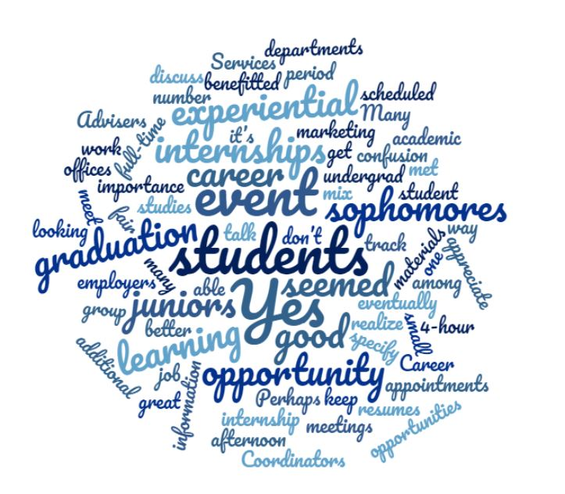
Feedback from Career Services Coordinators on the “Launch to Graduation and Beyond” event for sophomores and juniors:
Notes:
Mary - Again, met with over 50 students in 4 hours; loved the focus on opportunity.

Slide 31
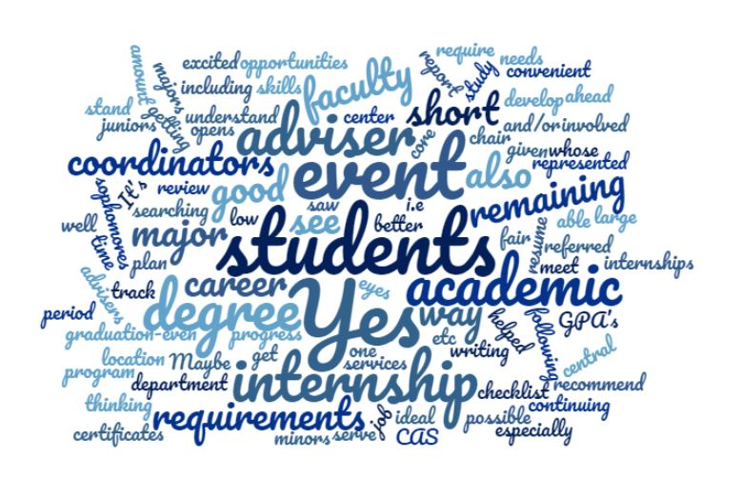
Feedback from Academic Advisers on the “Launch to Graduation and Beyond” event for sophomores and juniors:
Notes:
Mary

Slide 32
What did our team learn?
Good points
Collaboration and communication
Replication in other colleges
Students’ interest in internships
Improvements
Marketing through all campus avenues
Student Feedback before they leave the event
Ways to assess events in light of our university’s goals for student retention and degree completion
Notes:
Sophie

Slide 33

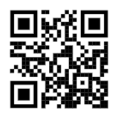
Share Your Ideas:
(1) What questions do students ask you about graduation?
(2) What has worked at your institution and why?
(3) What ideas do you have to make graduation and beyond a positive and valuable experience for students?
Or type in this URL: http://popin.it/na11c4
Open your smartphone camera and center on this QR Code to open the link

Slide 34


Slide 35
Buchtel College of Arts and Sciences
Gayle Bruno-Gannon, M.S.Ed., Academic Adviser II
gbrunogannon@uakron.edu
Sophie Kus Ed.D., Academic Adviser II
kuspate@uakron.edu
Terry Vance, M.Ed., Academic Adviser II
tv14@uakron.edu
Mary Cooke, B.A., Career Services Coordinator
mec@uakron.edu

Slide 36
Thank you
for your time
and
participation!

